Slide 1
Easwari Engineering College (Autonomous)
Department of Computer Science and Engineering
VOTE VAULT – Blockchain-Based System Using SHA-256 Algorithm and Smart Contract
Student Members:
Sai Krishna R (310618104079)
Saketh Raman R (310618104080)
Yuteesh S (310618104120)
Supervisor:
Ms. B. Shyamala Gowri
Assistant Professor
CSE Department
1

Slide 2
Objective
Easwari Engineering College (Autonomous)
Department of Computer Science and Engineering
To implement a voting system using the Ethereum blockchain mechanism which enforces the execution of the voting protocol.

Slide 3
Motivation
Easwari Engineering College (Autonomous)
Department of Computer Science and Engineering
To allow people to vote from the comfort of their homes and increase the voter turnout during elections.
To enhance the security of the voting process by using a decentralized blockchain mechanism.
3

Slide 4
Literature Survey (1)
Easwari Engineering College (Autonomous)
Department of Computer Science and Engineering
Dongliang Xu, Wei Shi, Wenshang Zhai, Zhihong Tian,
2021 ‘Multi-Candidate Voting Model-Based on Blockchain’,
IEEE/CAA Journal of Automatica Sinica, Vol.8, Issue: 12,
Page(s): 1891 - 1900.
Approaches used:
Blockchain mechanism.
Voting Anonymity Confusion algorithm.
ECC encryption.
4

Slide 5
Literature Survey(Contd.) (1)
Easwari Engineering College (Autonomous)
Department of Computer Science and Engineering
Achieved Result:
A multi-candidate voting model based on blockchain technology that ensures:
The preservation of anonymity during the voting process through ECC encryption and a signature mechanism;
The prevention of forgery of voting information by combining blockchain technology, automatic statistics, and the display of voting results through a smart contract.

Slide 6
Literature Survey(Contd.) (1)
Easwari Engineering College (Autonomous)
Department of Computer Science and Engineering
Issues:
The system is suitable only for small-scale voting situations.
ECC Encryption is complicated and tricky to implement securely, mainly the standard curves.

Slide 7
Literature Survey (2)
Easwari Engineering College (Autonomous)
Department of Computer Science and Engineering
Geetanjali Rathee, Razi Iqbal, Omer Waqar, Ali Kashif
Bashir, 2021, ‘On the Design and Implementation of a
Blockchain-Enabled E-Voting Application Within IoT-
Oriented SmartCities’, IEEE Access, Vol. 9, Issue-10
Page(s): 34165 - 34176.
Approaches used:
Blockchain mechanism.
Trust-based e-voting.
7

Slide 8
Literature Survey(Contd.) (2)
Easwari Engineering College (Autonomous)
Department of Computer Science and Engineering
Achieved Result:
Proposed mechanism has significantly outperformed the baseline mechanism and shows a better success rate in all simulation results against the baseline mechanism over message alteration, DoS, DDoS threats, and authentication mechanisms.
Issues:
Revolves around the topic of smart cities and can only be implemented in such cities.
Simulation model and does not have a working model.

Slide 9
Literature Survey (3)
Easwari Engineering College (Autonomous)
Department of Computer Science and Engineering
Somnath Panja, Samiran Bag, Feng Hao, Bimal Roy, 2020
‘A Smart Contract System for Decentralized Borda Count
Voting’, IEEE Transactions on Engineering Management,
Vol.67, Issue: 4, Page(s): 1323 - 1339.
Approaches used:
Blockchain mechanism.
Ethereum smart contracts.
9

Slide 10
Literature Survey(Contd.) (3)
Easwari Engineering College (Autonomous)
Department of Computer Science and Engineering
Achieved Result:
Implemented an E-Voting system that does not require a trusted party.
Issues:
Uses Borda Count Voting method.
Cannot be used in real-world applications.

Slide 11
Issues in the Existing Systems
Easwari Engineering College (Autonomous)
Department of Computer Science and Engineering
Existing voting system uses cryptography techniques, which, if not implemented properly makes the system highly vulnerable to attacks.
Current systems are fully centralized which reduces flexibility, and distributability, and embraces dictatorship.
Tallying authorities collide among themselves, thus voters’ privacy will be lost.
These systems depend on authorities to achieve voters’ privacy.
Many blockchain systems are concepts and do not have real-world applications since blockchain is new.
11

Slide 12
Proposed System
Easwari Engineering College (Autonomous)
Department of Computer Science and Engineering
Back End:
Blockchain is built using the Solidity language which is used to store the voter and vote data.
Metamask
SHA-256 Algorithm.
Node JS is used to connect the backend and frontend.
Front End:
A GUI using HTML and CSS is created for the voter to enter their credentials and also contains the list of parties they can vote for.
12

Slide 13
Proposed System(Contd.)
Easwari Engineering College (Autonomous)
Department of Computer Science and Engineering
Initially, a private key is generated using Ganache, and using Metamask, the voter creates a vote session.
The voter signs up into the system by entering their personal credentials which are encrypted using the SHA-256 algorithm to save the voter privacy and stored in the blockchain of that particular voter.
They then use the User ID and password they were provided upon sign-up to log into the system. After completion of login, they enter the voting system where they are provided with multiple parties from which they select their preference.

Slide 14
Proposed System(Contd.)
Easwari Engineering College (Autonomous)
Department of Computer Science and Engineering
Once they are done selecting the party and casting their vote, the vote data is stored in the blockchain of the particular voter along with their private credentials.
Finally, the admin can log in to an admin-only page to view the results of the election. Smart Contract is used during the blockchain creation process and the created blockchains are immutable.
Thus, the votes cannot be changed and since it is an online voting system, people can vote from the comfort of their homes which will increase the number of voters in the elections.

Slide 15
Proposed System(Contd.)
Easwari Engineering College (Autonomous)
Department of Computer Science and Engineering
Techniques used:
Metamask is an Ethereum network built as a browser plugin. It enables users to use the system by allowing them to store Ether and other ERC-20 tokens.
Two factors influenced our decision to choose the SHA-256 algorithm: (i) to begin with, the hash value cannot be used to recreate the original data. To generate starting data, a brute force attack would require 2256 attempts, and (ii) a tiny adjustment to the original data changes the hash value so drastically that it's not obvious the new hash value is generated from identical data.

Slide 16
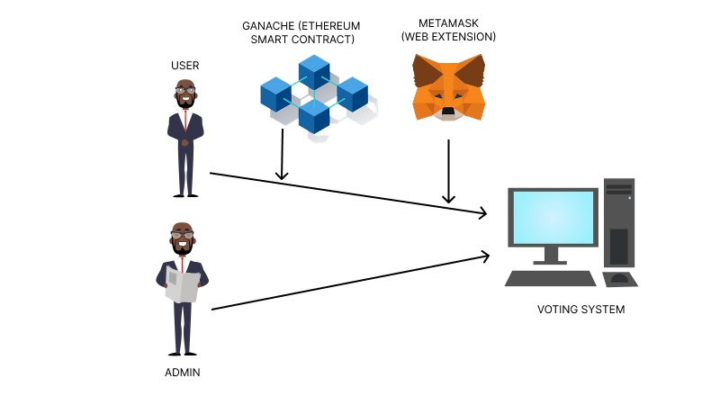
System Architecture
Easwari Engineering College (Autonomous)
Department of Computer Science and Engineering
Genesis block
16

Slide 17
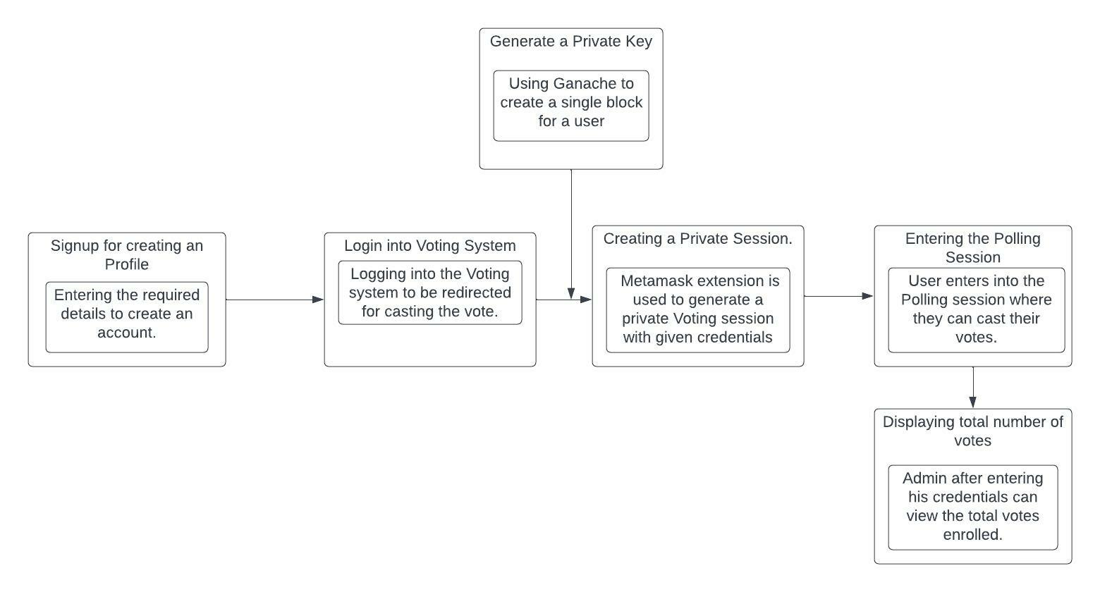
Functional Architecture
Easwari Engineering College (Autonomous)
Department of Computer Science and Engineering
Genesis block
17

Slide 18
List of Modules
Easwari Engineering College (Autonomous)
Department of Computer Science and Engineering
Module 1: Vote Session Creation
Module 2: Voter Login and Blockchain Creation
Module 3: Voting
Module 4: Vote Count (Admin Only)

Slide 19
System Requirements
Easwari Engineering College (Autonomous)
Department of Computer Science and Engineering
OS Platform: Windows 8 or above.
Development Tools: Smart Contract, HTML, CSS, ReactJS.
Language Platform: NodeJS, Solidity.
Database: Local Storage(150 GB).
4 GB Ram or above.

Slide 20
Input and Output of the System
Easwari Engineering College (Autonomous)
Department of Computer Science and Engineering
Input data:
Personnel credentials of the voter and the party preference.
Expected output of the system:
The system stores the vote information in the blockchain.

Slide 21
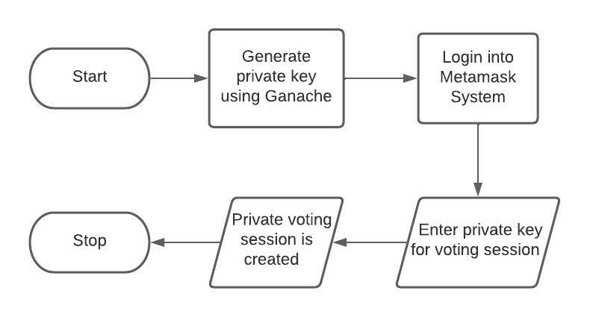
Module 1: Vote Session Creation
Easwari Engineering College (Autonomous)
Department of Computer Science and Engineering

Slide 22
Module 1: Vote Session Creation (Contd.)
Easwari Engineering College (Autonomous)
Department of Computer Science and Engineering
Each block formed in Ganache has a private number referred to as a Private Key, and the user who has to vote in the Voting System is provided with a different block.
Ganache is a personal blockchain and is a high-end development tool for rapid Ethereum and Corda distributed application development.
After logging in to Metamask with this private key, the user is able to access the voting system by starting a second session in which he is only allowed to vote once.

Slide 23
Module 1: Vote Session Creation (Contd.)
Easwari Engineering College (Autonomous)
Department of Computer Science and Engineering
After acquiring the Private key for the particular user, the User enters the Metamask credentials after logging in to Metamask which generates a private voting session allowing the user to vote once in the session using the given private key using a compatible web browser or the mobile app's built-in browser, users can use MetaMask to keep track of account keys, broadcast transactions, send and receive Ethereum-based money and tokens, and securely connect to decentralized apps.
MetaMask is an add-on for the Chrome browser. After connecting to Metamask and signing into the voting system, the user is allowed to log in and vote in the system.

Slide 24
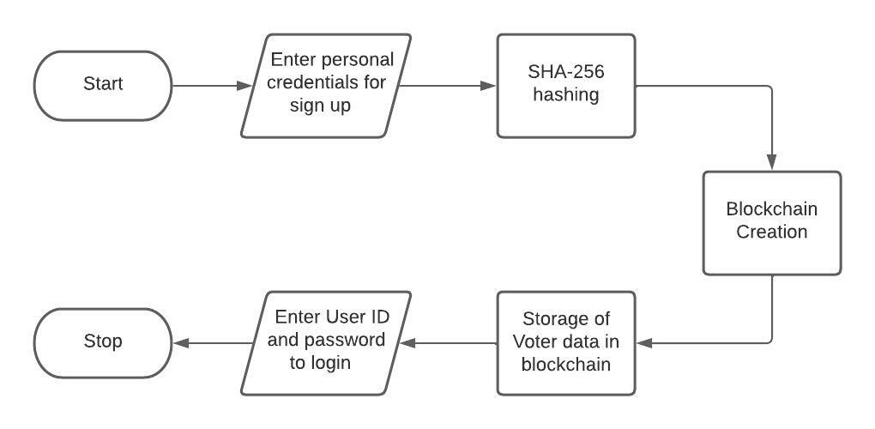
Module 2: Voter Login and Blockchain Creation
Easwari Engineering College (Autonomous)
Department of Computer Science and Engineering

Slide 25
Module 2: Voter Login and Blockchain Creation (Contd.)
Easwari Engineering College (Autonomous)
Department of Computer Science and Engineering
After generating a private key using Ganache and creating a vote session using MetaMask, the voter is then allowed to register with the voting system.
Firstly, the voter must enter their personal credentials like name, date of birth, Aadhar details, etc and the given voter data is hashed using the SHA-256 algorithm.
Once the data is hashed a blockchain is created which is specific to that particular voter.
The User ID and password are then generated which the voter uses to log in to the system to cast their vote.

Slide 26
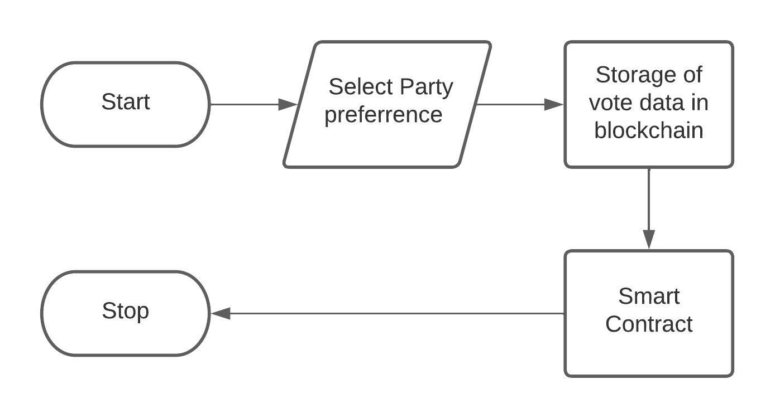
Module 3: Voting
Easwari Engineering College (Autonomous)
Department of Computer Science and Engineering

Slide 27
Module 3: Voting (Contd.)
Easwari Engineering College (Autonomous)
Department of Computer Science and Engineering
Users are allowed into the voting page after setting up Metamask and logging into the system using the credentials done in sign up.
After logging in, the user has to select the party for which he/she wants to vote from the dropdown menu and click the party for whom he wants to select and submit the vote.
After a user registers their vote, the vote becomes immutable because it is permanently stored in the block, and when the user logs in again they cannot vote again.

Slide 28
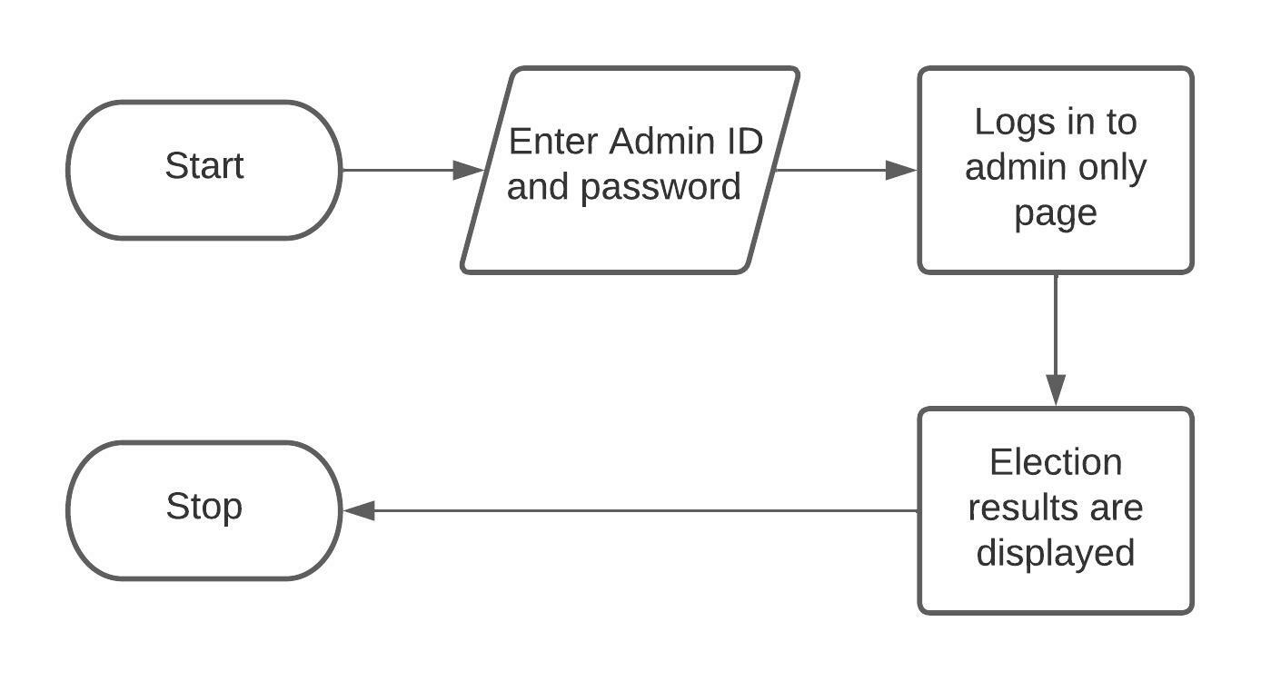
Module 4: Vote Count(Admin Only)
Easwari Engineering College (Autonomous)
Department of Computer Science and Engineering

Slide 29
Module 4: Vote Count(Admin Only) (Contd.)
Easwari Engineering College (Autonomous)
Department of Computer Science and Engineering
After the user votes in the system, there is no more accessibility for them in the system.
The result of the election, which is the total number of votes acquired by each party can only be seen by the admin in the admin login where the admin has no access to manipulation of data.
The total number of votes cast for each party is published in a table, and the party with the most votes is declared the election winner.

Slide 30
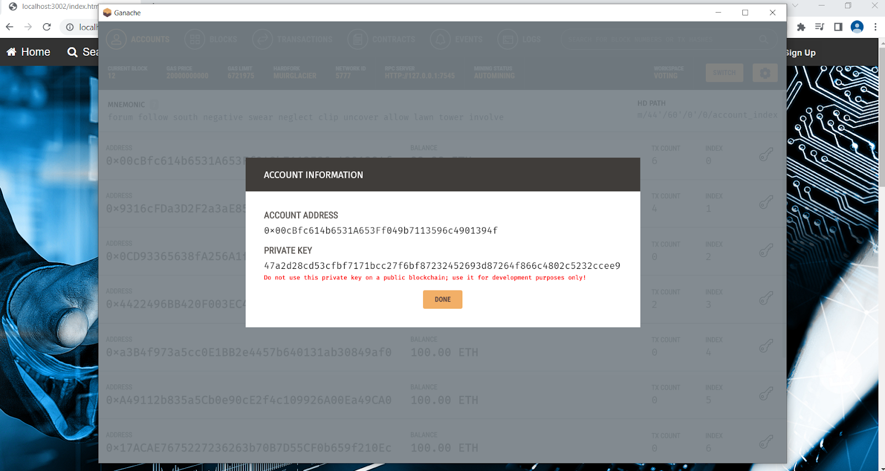
Snapshots of the Results
Easwari Engineering College (Autonomous)
Department of Computer Science and Engineering

Slide 31

Easwari Engineering College (Autonomous)
Department of Computer Science and Engineering

Slide 32
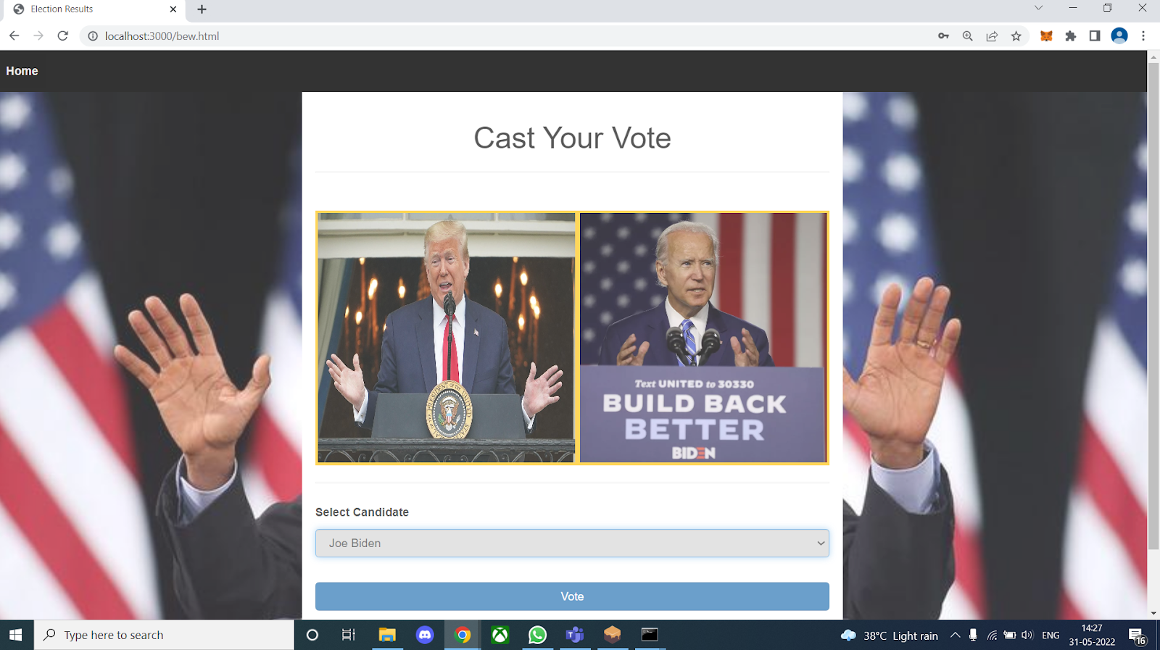
Easwari Engineering College (Autonomous)
Department of Computer Science and Engineering

Slide 33
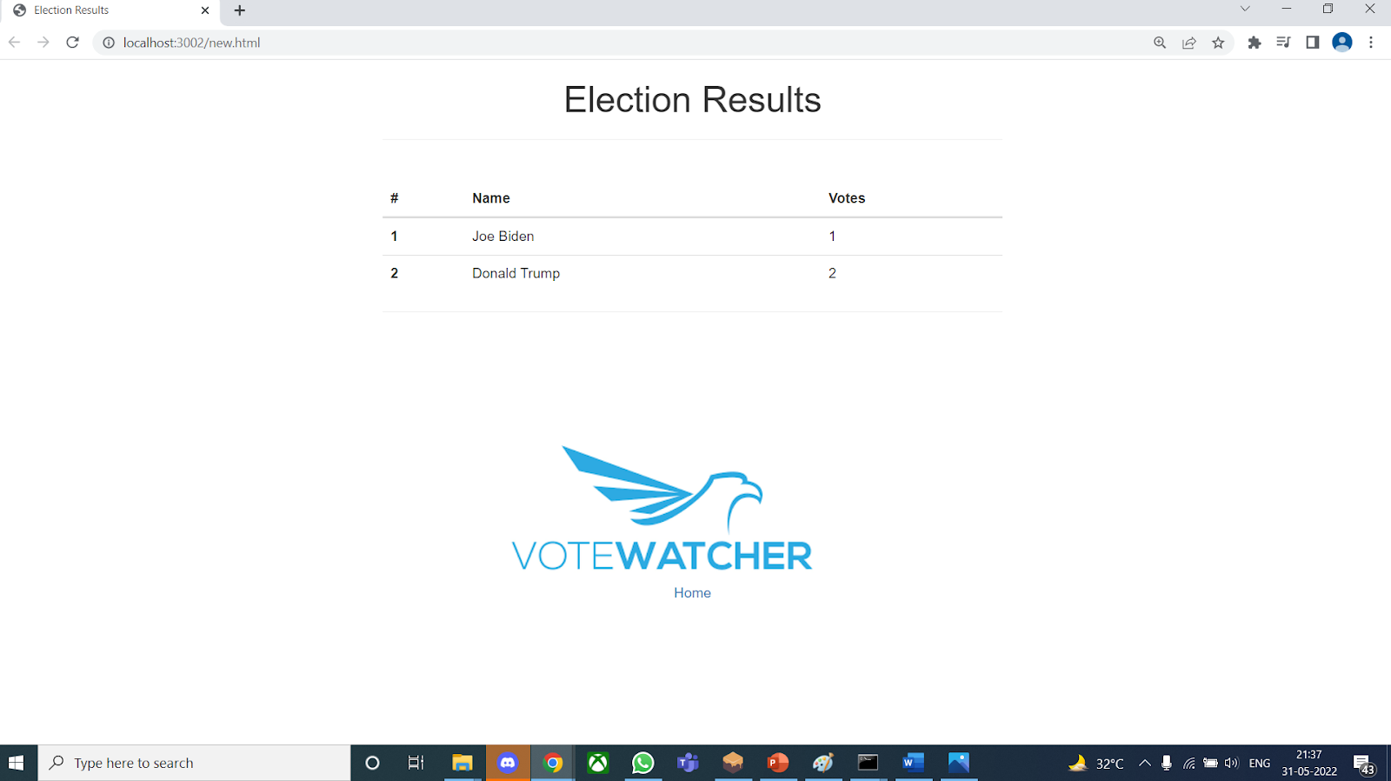
Easwari Engineering College (Autonomous)
Department of Computer Science and Engineering

Slide 34
Applications
Easwari Engineering College (Autonomous)
Department of Computer Science and Engineering
The system can be used as a real-world alternative election method to increase security, and voter privacy and make Voting Online.

Slide 35
Conclusion and Future Work
Easwari Engineering College (Autonomous)
Department of Computer Science and Engineering
In today's world, the idea of adapting digital voting techniques to make the public political process cheaper, faster, and easier is appealing. This paper is thus made to give the readers a survey of various papers on blockchain-based voting systems.
Making the voting process inexpensive and quick normalizes it in the eyes of voters, lowers a power barrier between the voter and the elected official, and puts pressure on the elected official.

Slide 36
Conclusion and Future Work(Contd.)
Easwari Engineering College (Autonomous)
Department of Computer Science and Engineering
We presented a novel blockchain-based electronic voting system in this study that provides secure and cost-effective elections. To protect the privacy of the voter, we employed the SHA-256 hashing mechanism. The vote data of each voter is stored using an Ethereum-based blockchain system, and the vote data is protected in the blockchain.
In the future, we would like to immunize our system against various attacks such as DDOS and Phishing
We would also like to take our project mainstream by using it in real-life election processes.

Slide 37
References
Easwari Engineering College (Autonomous)
Department of Computer Science and Engineering
[1] Dongliang Xu, Wei Shi, Wenshang Zhai, Zhihong Tian, 2021 ‘Multi-Candidate Voting Model Based on Blockchain’, IEEE/CAA Journal of Automatica Sinica, Vol.8, Issue: 12, Page(s): 1891 - 1900.
[2] Geetanjali Rathee, Razi Iqbal, Omer Waqar, Ali Kashif Bashir, 2021, ‘On the Design and Implementation of a Blockchain-Enabled E-Voting Application Within IoT- Oriented SmartCities’, IEEE Access, Vol. 9, Issue-10 Page(s): 34165 - 34176.
[3] Somnath Panja, Samiran Bag, Feng Hao, Bimal Roy, 2020 ‘A Smart Contract System for Decentralized Borda Count Voting’, IEEE Transactions on Engineering Management, Vol.67, Issue: 4, Page(s): 1323 – 1339.
37

Slide 38
Easwari Engineering College (Autonomous)
Department of Computer Science and Engineering
Thank You
38

